Slide 1
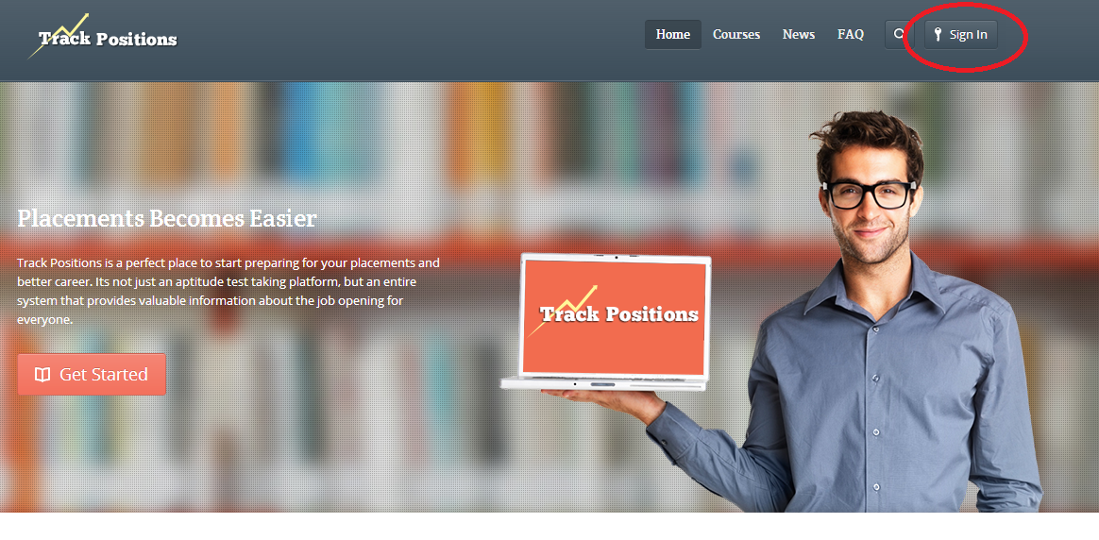
Open www.Trackpositions.com
Click on sign in and enter username and password details.

Slide 2
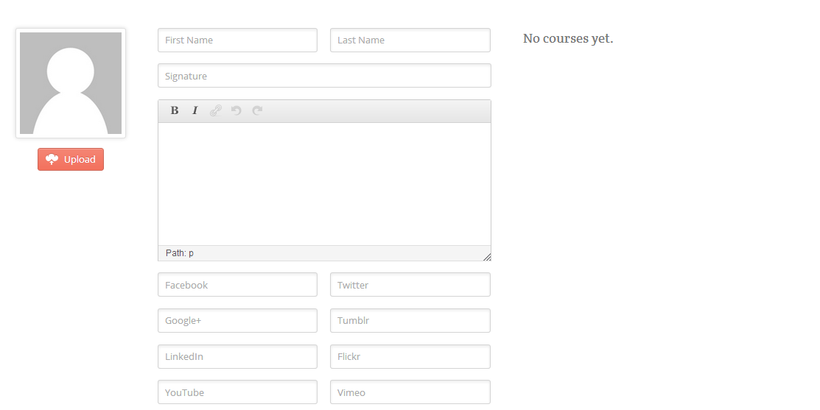
Fill in your details (if required) in profile page else you can ignore updating details.

Slide 3
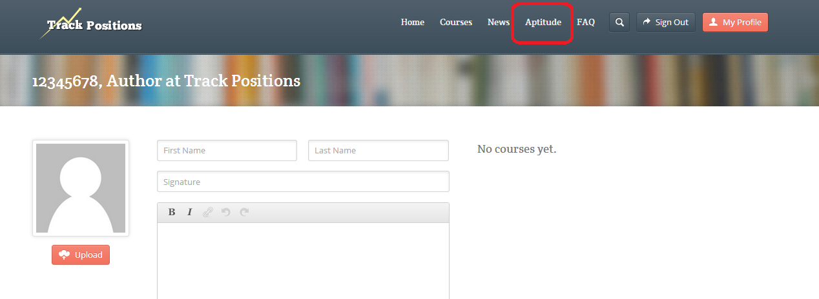
Click on Aptitude on top right

Slide 4
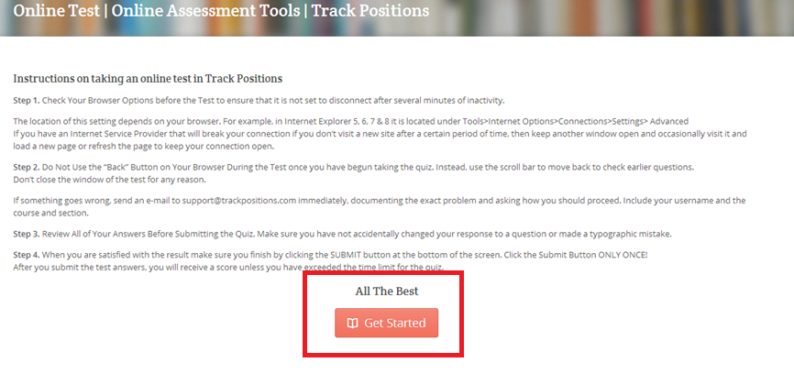
Read the instructions carefully
and click on Get started.
Aptitude test will start as soon as “get started button is clicked”

Slide 5
Few important instructions
A student can take up test only once.
Once the test is submitted, you can’t change the answers.
Make sure you answer all the questions before submitting.
No negative marks

Slide 6
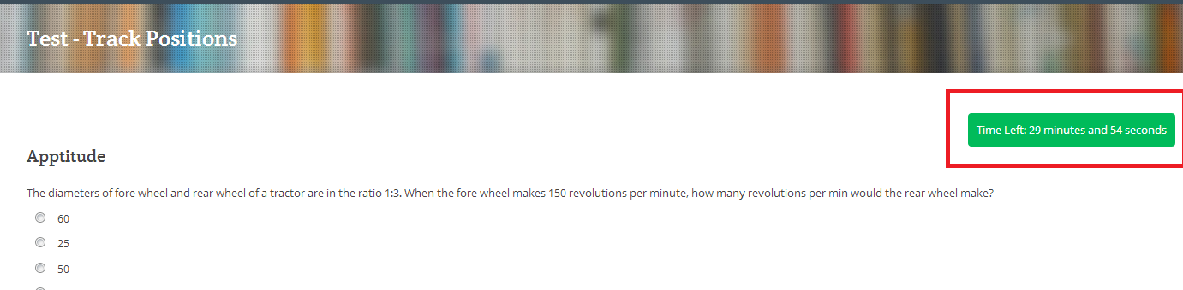
Aptitude test with Timer will be shown.

Slide 7
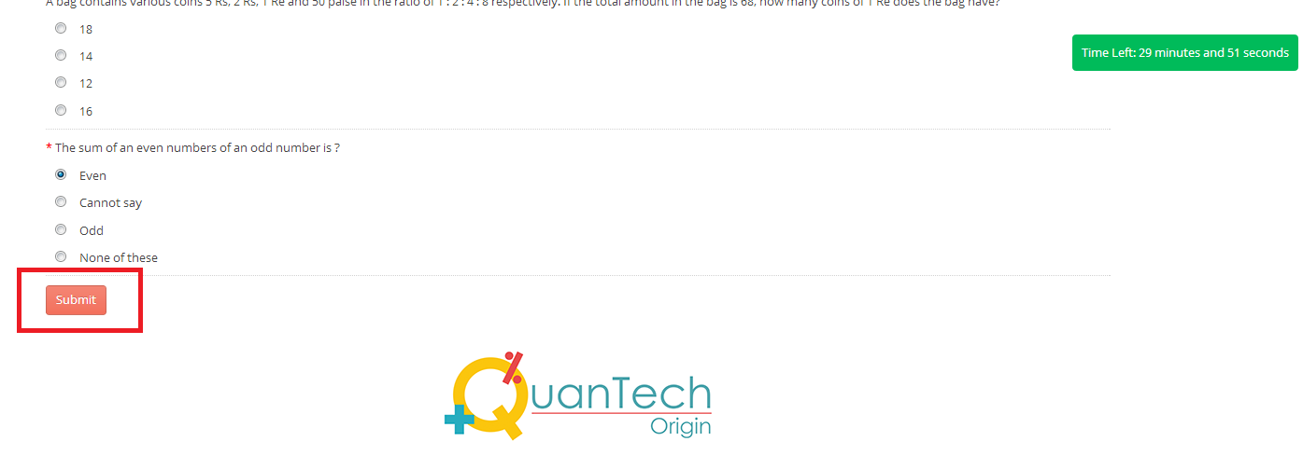
Once the test is completed. Click on submit button at the bottom of the page.
Test will be auto submitted once time expires.

Slide 8
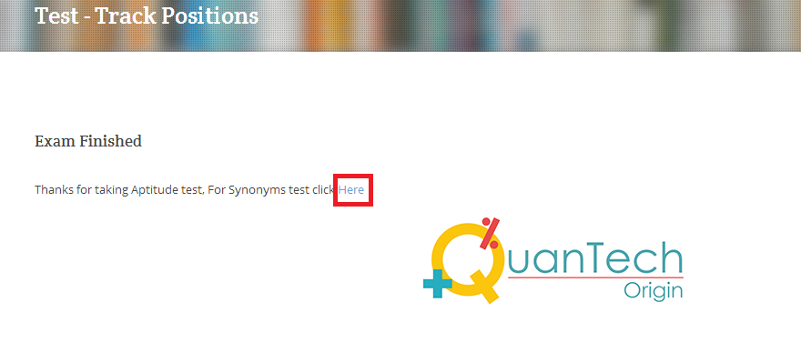
After finishing Aptitude exam, students can take up synonyms and antonyms test by clicking the link provided after finishing aptitude test.

Slide 9
After submission of test answers, results will be mailed to student email id’s directly.

Slide 10
Thank you
TrackPositions.com contactus@trackpositions.com

